Slide 1
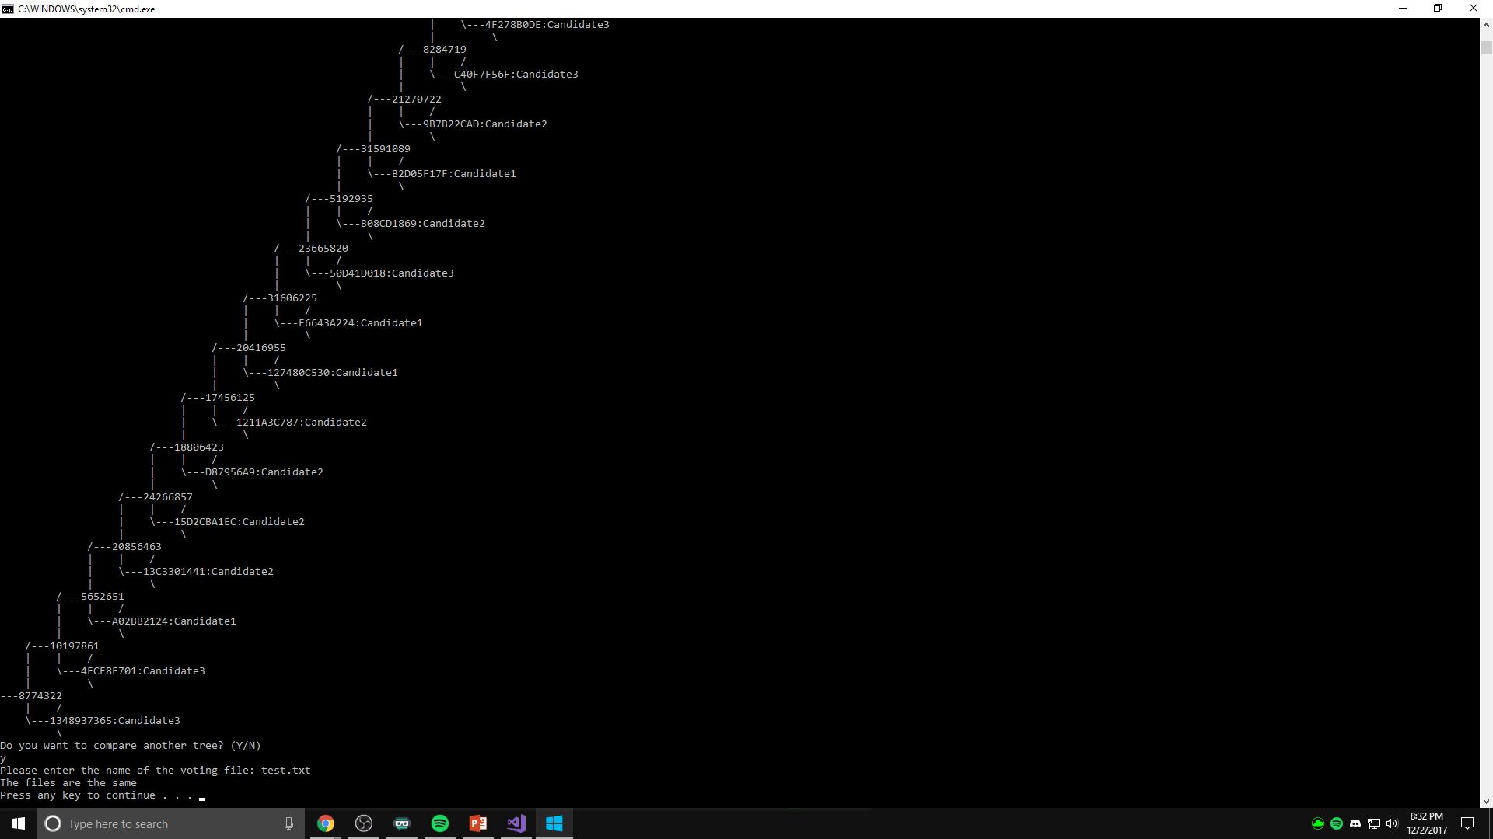



Fall 2017 | CS 2030 | UWYO
Limitations & Challenges
Merkle Votes Hashing Within Binary Trees
Our group ran into issues regarding the building and display of a binary tree, which lead to discussion on how the logic worked and the solution to building correctly. The Merkle tree functions regarding the number of operations also took a fair amount of thinking through. Our group worked together in order to debug any issues that halted progress on the project and produced a solid project in the end.
Sam Blair, Sam Goering, Oyedola Ajao, and Easton Tuttle
4 Hashes
Motivation
Sam Blair’s hash
This hash function was used for UNIX devices. It bitwise shifted the entry to create the hash. It first shifts the hash left by four. Then it checks if not zero to preform the next operation. Lastly it shifted the whole hash right by 24 bits with an exclusive or. This was the ELF function that was based off of PJW. hash function.
Sam Goering’s hash function: The hash function passes a string(key) in to the hash. A seed of 78498 which is a prime number is initialized. The function iterates through the string multiplying each character by the seed then exclusive or with a bitwise shifting left by 2 then exclusive or with the bitwise shift right by 15.
Oyedola Ajao’s hash:
This hash function takes in a key of type string. A hash and index (i) are initialized to zero. The length of the key is set to length (len). There is then a loop that states, so long as the index is smaller than the length, then the hash is equal to the key at the index added to the hash moved to the right 6, and added to the hash moved to the left 16, minus the hash.
Easton’s hash Description of my hash function: The hash function takes in a key (of type string) in as a parameter. For the length of the key, the hash value (originally 1) is multiplied by 0x811C9DC5. This value is then taken to the ith power during the for loop. After the for loop convert the string to an integer and return that integer as the hashed value.
The creation of a Merkel tree allows for votes to be stored via encryption. Specifically, hashing the names of the voters or identification associated with their vote. This allows for voters to remain anonymous which provides a good sense of privacy. This privacy could prove useful for countries or regions where voters are prosecuted by opposing sides for who they voted for. In todays age these groups get this information from poorly secured data structures which do not hide voter information.
Background
Our group was able to complete this Merkle tree with our knowledge of data structures and how to implement them. The important data structures to understand during this project include: linked lists and, custom tree nodes containing-a time stamp, data, and two node pointers.
Results
Number of operations to insert a data node: O(3/2 (n))
Number of operations to re-compute hashes on entry of a new node: O(n-1)
Number of operations to compare if two trees are identical: O(2n)
Number of operations to determine if two trees differ: O(2n)
Project Summary & Major Tasks
Putting our minds together, our group was able to build a binary tree which consists of nodes that contain two pointers which link up the whole tree. This created a binary tree which was then used as the skeleton of the Merkle tree. This Merkle tree implementation meant that votes could only be inserted as leaves to the binary tree and then each parent node in the tree would contain hashed values of their leave added together.
Conclusions & Future Work
For our team, this project was a great way to learn the structure and implementation of a binary tree through practice. The final result turned out to be something that all of us were impressed with. In the future we hope that this work helps us to keep in mind a security viewpoint when developing, no matter the application type.
Thank you to Rafer Cooley and Mike Borowczak for
their help on this project!
This poster made possible by:
UWYO College of Engineering & Applied Science, UWYO Computer Science Department, and UWYO CEDAR.

